Slide 1

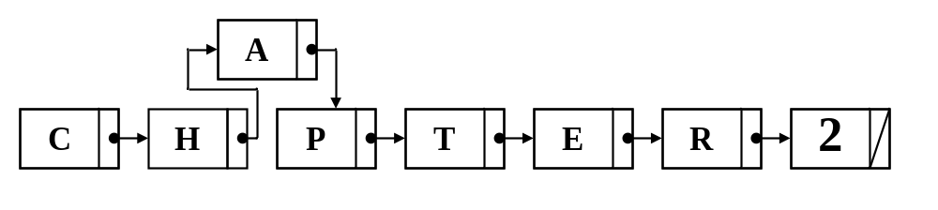
Java
Methods AB
TM
Maria Litvin
Gary Litvin
Data Structures
Lists and Iterators
Copyright © 2003-2004 by Maria Litvin, Gary Litvin, and Skylight Publishing. All rights reserved.

Slide 2
Objectives:
Learn about the List data structure
Learn some of the methods of the java.util.List interface
Learn the advantages and shortcomings of java.util.ArrayList and java.util.LinkedList
Learn about iterators
Learn to work with ListNode objects and do-it-yourself linked lists
2-<number>
Notes:
The AP CS course description indicates that students must be familiar with the java.util.List interface and java.util.ArrayList and LinkedList classes, as well as with manipulating “do-it-yourself” linked lists based on the College Board’s ListNode class.

Slide 3
List Data Structure
A list:
Contains numbered items (entries, values, elements):
a₀, a₁, ..., a_{n-1}
Can contain duplicate items
Has methods to get, set, and remove the i-th item and to add or insert an item
2-<number>
Notes:
The main difference between a list and other collections is that we can refer to the elements of a list using their indices.

Slide 4
java.util.List Interface
List belongs to the java.util library package
List extends a more general interface, java.util.Collection
Use
import java.util.*;
when working with lists
2-<number>
Notes:
Thus a List IS-A Collection.

Slide 5
List Interface (cont’d)
A List holds references to objects
Can contain references to two equal objects (a.equals (b)) as well as two references to the same object (a == b)
An object can belong to several lists
An object can change while in a list
2-<number>
Notes:
An analogy: links to the same web page can be found on many lists of links; the contents of the web page can change while it remains on the lists.

Slide 6
Library Implementions of List
java.util.ArrayList
  implemented as an array
java.util.LinkedList
  implemented as a doubly-linked list
a₀
a₁
a₂
...
a_{n-1}
head
a₀
a₁
tail
a₂
...
a_{n-1}
2-<number>
Notes:
Each of this library implementations has its pros and cons; they will be discussed shortly.

Slide 7
List’s Methods
* Quick Reference Guide
  int size();
  boolean add (E obj);
  void add (int index, E obj);
  E get (int index);
  E set (int index, E obj);
  E remove (int index);
  Iterator<E> iterator()
  ListIterator<E> listIterator()
returns true
inserts obj as the i-th value; i must be from 0 to size()
i must be from 0 to size() -1
2-<number>
Notes:
For some reason, isEmpty, contains , and indexOf are not in the AP subset; all the other methods listed are.

Slide 8
List’s Methods
* Not in Quick Reference Guide
  boolean isEmpty ();
  boolean contains (E obj);
  int indexOf (E obj);
uses equals to compare objects
2-<number>
Notes:
For some reason, isEmpty, contains , and indexOf are not in the AP subset; all the other methods listed are.

Slide 9
List Methods — Details
  int size (); // Returns the number of values
  // currently stored in the list
  boolean isEmpty (); // Returns true if the list is empty,
  // otherwise returns false
  boolean add (E obj);
  // Appends obj at the end of the list;
  // returns true
  void add (int index, E obj);
  // Inserts obj at position index
  // (0 < index < size) moving elements
  // at position index and higher to the right
  // (adds 1 to their indices) and adjust size
Throws IndexOutOfBoundsException when i < 0 or i > size ()
2-<number>
Notes:
In general, indices must be in the range between 0, and size() - 1, but in the add(obj, index) calls index is allowed to be equal to size() (for adding at the end of the list).

Slide 10
List Methods — Details (cont’d)
  E get (int index); // Returns the value of the index-th
  // element
  E set (int index, E obj);
  // Replaces the element at position
  // index with obj;
  // returns the old value
  E remove (int index);
  // Removes the element at position
  // index, moving elements at
  // position index = 1 and higher to
// left (subtract 1 from their indices)
// and adjust size.
// returns the element formerly at
// specified position
These three methods throw IndexOutOfBoundsException when i < 0 or i ≥ size ()
2-<number>
Notes:
It is a very common mistake to forget that remove reduces the size of the list and shifts the indices of the subsequent elements down by one.

Slide 11
List Methods — Details (cont’d)
  boolean contains (E obj);
  // Returns true if obj is equal to one
  // of the objects in the list, otherwise
  // returns false
  int indexOf (E obj);
  // Returns the index of the first
  // occurrence of an object in the list
  // that is equal to obj, or -1 if none
  // is found
2-<number>
Notes:
indexOf — a convenient method for locating a given value in the list — is not in the AP subset, but you can use it in FR solutions if necessary.

Slide 12
List (cont’d)
A List holds references of the type E;
List<String> bandNames = new ArrayList <String>( );
bandNames.add ("ABBA");
...
String name = bandNames.get (i);
adding a String
2-<number>
Notes:
It is programmer’s responsibility to remember which types of objects he put into the list.

Slide 13
List (cont’d)
If you need to store values of primitive data types in a List, you need to convert them into objects first
List<Object> numbers = new LinkedList<Object> ( );
numbers.add ( new Integer ( 10 ) );
numbers.add ( new Double ( 1.5 ) );
...
int x = ((Integer)numbers.get (0)).intValue ( );
converting to int
2-<number>

Slide 14
ArrayList
Implements a list as an array
Provides random access to the elements
  get (i) and set (i) work “instantaneously” regardless of the size of the list
Inserting and removing values is less efficient — requires shifting of subsequent values
  on average, remove(i) and add(i, obj) take time proportional to the size of the list
2-<number>
Notes:
Usually the array that holds the list values has room to add a value at the end. In that case, list.add(obj) takes a small fixed amount of time.

Slide 15
ArrayList (cont’d)
Keeps track of the list capacity (the length of the allocated array) and list size (the number of values currently in the list)
An ArrayList is automatically reallocated if it runs out of space; all the values are then copied into a larger array (about twice the size)
capacity
size
"Cat"
"Hat"
"Bat"
2-<number>
Notes:
Reallocation happens infrequently, so on average, add(obj) still takes a fixed amount of time regardless of the size of the list.

Slide 16
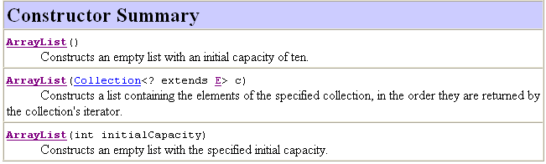
ArrayList (cont’d)
From Java API Docs:
2-<number>
Notes:
Only the no-args constructor is required for the AP exams.

Slide 17
ArrayList (cont’d)
From Java API Docs:
The size, isEmpty, get, set, iterator, and listIterator operations run in constant time, O(1) time.
The add operation runs in amortized constant time, that is, adding n elements requires O(n) time.
All of the other operations run in linear time (roughly speaking).
The constant factor is low compared to that for the LinkedList implementation.
2-<number>

Slide 18
ArrayList Example 1
ArrayList<Integer> list = new ArrayList<Integer> ( );
list.add (new Integer(1));
list.add (new Integer(2));
list.add (new Integer(3));
int sum = 0;
for (int i = 0; i < list.size(); i++)
sum += ( list.get(i).intValue( ) );
2-<number>

Slide 19
ArrayList Example 2
ArrayList<String> words = new ArrayList<String> ( );
words.add ("One");
words.add ("Fish");
words.add ("Two");
words.add ("Fish");
int i = 0;
while ( i < words.size() )
{
if ( "Fish".equals (words.get (i) ) )
words.remove (i);
else
i++;
}
shifts all the values after the i-th to the left and decrements the size
2-<number>
Notes:
If you use a typical for loop —
for (i = 0; i < words.size(); i++)
— you will miss the situations with two matches in a row (e.g., “One”, “Two”, “Fish”, “Fish”).

Slide 20
LinkedList
Implements a list as a doubly-linked list
No random access to the elements — traverses the list to get to the i-th node
Inserting and removing values is done by rearranging the links — no shifting
Operations perform as could be expected for a doubly linked list.
Operations that index into the list will traverse the list from beginning or the end, whichever is closer
2-<number>
Notes:
ArrayList advantages:
“instantaneous” random access to the element with a given index;
can use binary search if the list is sorted.
Disadvantages:
need to shift subsequent values when a value is added or removed at
the beginning or in the middle;
need to reallocate the array when it runs out of space.

Slide 21
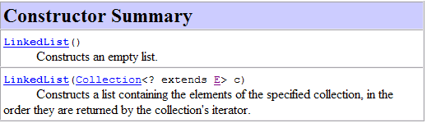
LinkedList (cont’d)
From Java API Docs:
2-<number>
Notes:
Only the no-args constructor is required for the AP exams.

Slide 22
Additional Methods Specific to LinkedList
  void addFirst (E obj);
  // Appends obj at the beginning of the list
  void addLast (E obj);
  // Appends obj at the end of the list
  E getFirst (); // Returns the first element
  E getLast (); // Returns the last element
  E removeFirst (); // Removes the first element from the
  // list and returns it
  E removeLast (); // Removes the last element from the
// list and returns it
2-<number>
Notes:
You need to declare specifically a LinkedList to use these methods.
List list = new LinkedList();
...
list.addLast(obj);
— doesn’t work! You need
LinkedList list = new LinkedList();
...

Slide 23
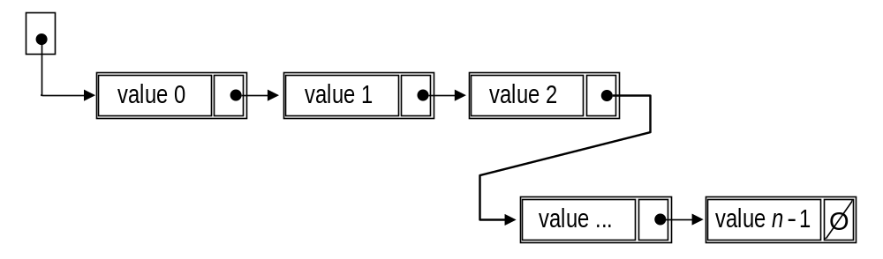
Linked List Basics
Each node holds a reference to the next node
In the last node, next is null
A linked list is defined by a reference to its first node (often named head)
head
2-<number>

Slide 24
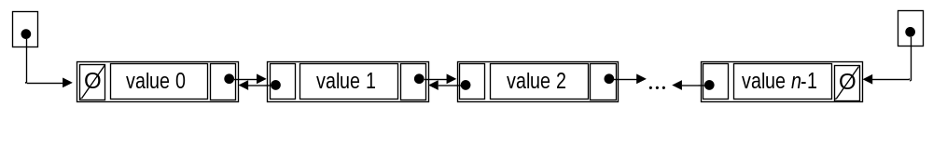
Linked List Basics (cont’d)
In a doubly-linked list, each node holds a reference to the next and the previous node
head
tail
2-<number>

Slide 25
Linked Lists — Do It Yourself
A node of a linked list is represented as an object of the class ListNode
public class ListNode
{
private Object value;
private ListNode next;
public ListNode(Object v, ListNode nx)
{ value = v; next = nx; }
public Object getValue ( ) { return value; }
public ListNode getNext ( ) { return next; }
public void setValue (Object v) { value = v; }
public void setNext (ListNode nx) { next = nx; }
}
A reference to the next node
2-<number>
Notes:
For some reason, ListNode does not have a constructor
ListNode(Object v)
{ value = v; next = null; }

Slide 26
ArrayList vs. LinkedList (cont’d)
 | ArrayList | LinkedList
get(i) and set(i, obj) | O(1) | O(n)
add(i, obj) and remove(i) | O(n) | O(n)
add(0, obj) | O(n) | O(1)
add(obj) | O(1) | O(1)
contains(obj) | O(n) | O(n)
2-<number>
Notes:
Usually the array that holds the ArrayList’s values has room to add a value at the end. In that case, list.add(obj) takes O(1) time.

Slide 27
Iterators
java.util.Iterator is an interface
An iterator is an object of a class that implements Iterator
An iterator object is created for a given collection; it allows you to visit all the elements of the collection one by one
The behavior of an iterator is unspecified if the underlying collection is modified while the iteration is in progress in any way other than by calling the remove method. Translation – Do not modify the Collection!
2-<number>
Notes:
Iterator is an interface rather than a class because different types of collections require different implementations of Iterator.

Slide 28
Iterators (cont’d)
We don’t often see a class that implements Iterator because it is usually a private inner class inside the class that implements the collection
An iterator is returned by the collection’s iterator method
For a list, an iterator visits the elements in the same sequence as they are stored in the list, starting at the first
2-<number>
Notes:
It is convenient to implement Iterator in an inner class because then it has access to the private fields of the collection. For example, an iterator for a LinkedList needs access to the head of the list, which is a private field. An iterator for an ArrayList needs access to the array that holds the list.

Slide 29
Iterator Methods
  E next ( ); // Returns the next element
  // (when called for the first time,
  // returns the element at index 0)
  boolean hasNext ( );
  // Returns true if there are more
  // elements to visit in the collection
  // and false otherwise
  void remove ( ); // Removes the last element that was
  // return by next
2-<number>
Notes:
next also advances the iterator to the next element.
Think of the iterator position as a cursor positioned between list values. next returns the value just ahead of the cursor and advances the cursor.
Be careful not to call next twice within a loop — that would skip elements.

Slide 30
Iterator Example 1
  // precondition: list contains Doubles
  public sum (List<Double> list)
  {
  double sum = 0;
  Iterator <Double> iter = list.iterator ( );
  while ( iter.hasNext ( ) )
  {
  Double x = iter.next ( );
  sum += x.doubleValue ( );
  }
  return sum;
  }
2-<number>

Slide 31
Iterator Example 2
  public void removeConsecutiveDuplicates (List<String> list)
  {
  Iterator<String> iter = list.iterator ( );
  if (! iter.hasNext ( ) )
  return; // empty list
  String current = iter.next ( );
  while ( iter.hasNext ( ) )
  {
  String str = iter.next ( );
  if ( current.equals (str) )
  iter.remove ( );
  else
  current = str;
  }
  }
A common bug:
if (current.equals( iter.next() ))
iter.remove ( );
else
current = iter.next();
(next called twice)
2-<number>
Notes:
remove removes the last element returned by next (before the cursor, like the backspace key) and leaves the cursor in place (i.e., positioned before the next element).

Slide 32
Indices vs. Iterators
for (int i = 0; i < list.size(); i++)
{
E x = list.get (i);
...
}
Iterator<E> iter = list.iterator ( );
while (iter.hasNext ( ))
{
E x = iter.next ( );
...
}
Works well for an ArrayList;
inefficient for a LinkedList
Works well for both an ArrayList and a LinkedList
2-<number>
Notes:
For an ArrayList, get(i) takes small constant time, regardless the size of the list n. For a LinkedList, get(i) takes time proportional to n. So a traversal of a LinkedList using indices takes time proportional to n².

Slide 33
java.util.ListIterator
Extends Iterator
Adds methods specific to traversing a doubly-linked list
A ListIterator object is returned by the listIterator() or listIterator(pos) method of the list
cursor position always lies between the element that would be returned by a call to previous() and the element that would be returned by a call to next().
2-<number>
Notes:
So Iterator is for any collection, while ListIterator is specifically for a List.

Slide 34
ListIterator Methods
* Quick Reference Guide
(in addition to next, hasNext, remove)
  void set (E obj); // Sets the last element returned
  // by next or previous to obj
  // i.e., replaces the last element returned
  // by next with obj (prev not part of subset)
  void add (E obj); // Adds obj “at” the current “cursor” position
  // i.e., adds obj before the element that
  // will be returned by next .
2-<number>
Notes:
Only set and add are in the AP subset.

Slide 35
ListIterator Methods
* NOT in Quick Reference Guide
(in addition to next, hasNext, remove)
  E previous ( ); // Returns the previous element
  boolean hasPrevious ( ); // Returns true if there is a
  // previous, false otherwise
  int nextIndex ( ); // Returns the index of the
  // next element
  int previousIndex ( ); // Returns the index of the
  // previous element
2-<number>
Notes:
Only set and add are in the AP subset.

Slide 36
ListIterator Methods
(add a view from the API)
void add (Object obj);
        Inserts the specified element into the list. The element is inserted immediately before the next element that would be returned by next, if any, and after the next element that would be returned by previous, if any.
        The new element is inserted before the implicit cursor: a subsequent call to next would be unaffected, and a subsequent call to previous would return the new element.
2-<number>

Slide 37
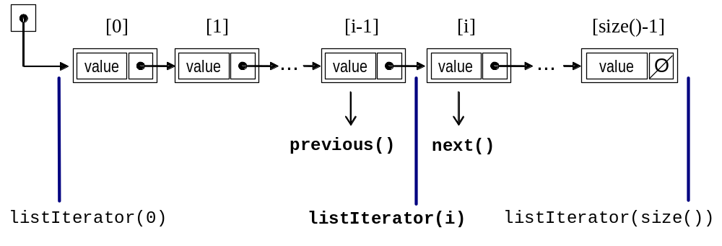
ListIterator “Cursor” Positioning
add
(Reverse links not shown)
2-<number>
Notes:
So add(x) inserts x just before the “cursor.”

Slide 38
Review:
What are the properties of a list?
Name the key methods of the java.util.List interface.
How is ArrayList implemented?
What is the difference between the capacity and the size of an ArrayList?
How is LinkedList implemented?
2-<number>
Notes:
What are the properties of a list?
The values in the list are indexed from 0 to size() - 1; a list can hold duplicate values.
Name the key methods of the java.util.List interface.
isEmpty, size, get, add.
How is ArrayList implemented?
An ArrayList has an array that holds list values and keeps track of the number of values currently in the list.
What is the difference between the capacity and the size of an ArrayList?
Capacity indicates how many values can be stored in the array without allocating a bigger array; size is the number of values currently stored in the list.
How is LinkedList implemented?
As a double-linked list of nodes; each node has the references to the next and the previous node.

Slide 39
Review (cont’d):
Compare the efficiency of the get(i) method for an ArrayList and a LinkedList.
Name a few methods specific to LinkedList.
What does an object of the ListNode class represent?
Which fields and methods have to be added to ListNode to make it suitable for doubly-linked lists?
2-<number>
Notes:
Compare the efficiency of the get(i) method for an ArrayList and a LinkedList.
The time it takes is constant (regardless of the size of the list) for an ArrayList and proportional to the size of the list for a LinkedList.
Name a few methods specific to LinkedList.
addFirst, addLast, removeFirst, removeLast.
What does an object of the ListNode class represent?
A node of a singly-linked list.
Which fields and methods have to be added to ListNode to make it suitable for doubly-linked lists?
A field previous and methods getPrevious and setPrevious.

Slide 40
Review (cont’d):
What is an iterator?
How can we obtain an iterator for a given list?
What happens when we call iter.next() when there is no next element.
Name a few methods specific to ListIterator.
Can you start iterations at any given position in the list?
2-<number>
Notes:
What is an iterator?
It is an object that helps to visit each element of a given collection once.
How can we obtain an iterator for a given list?
By calling its iterator method.
Guess what happens when we call iter.next() when there is no next element.
It throws NoSuchElementException.
Name a few methods specific to ListIterator.
hasPrevious, previous, add.
Can you start iterations at any given position in the list?
Yes, by using the iterator returned by the list.listIterator(index) call.

